Slide 1
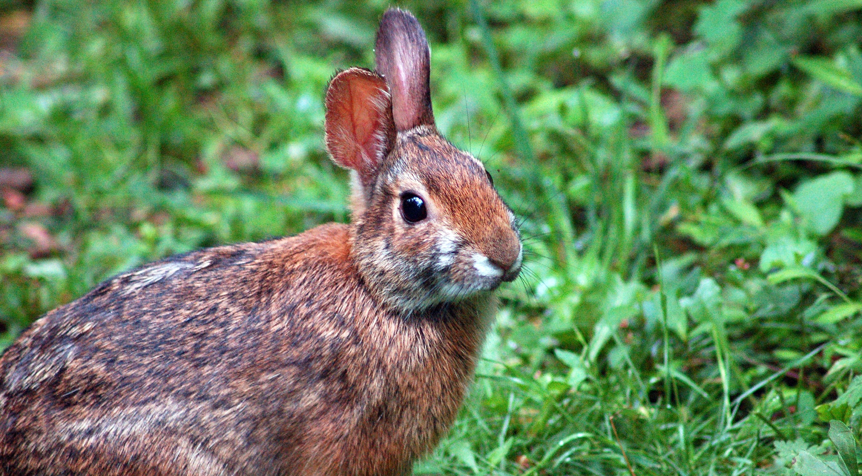
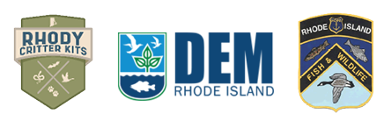
Young Forest Wildlife:
The New England Cottontail
RI DEM Division of Fish and Wildlife
Rhody Critter Kits Program

Slide 2
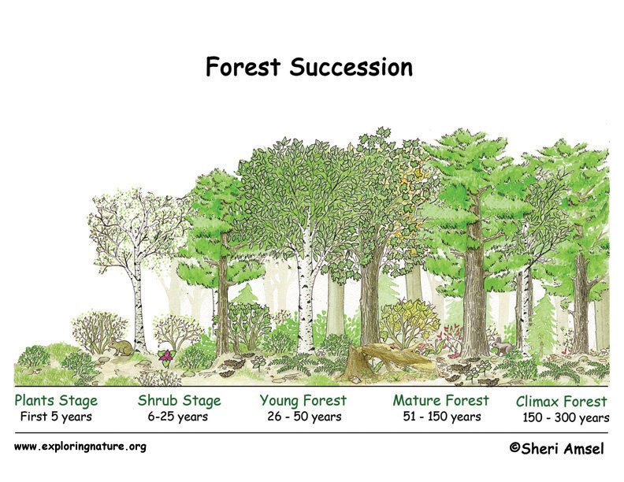
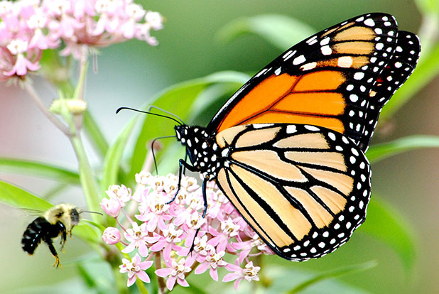
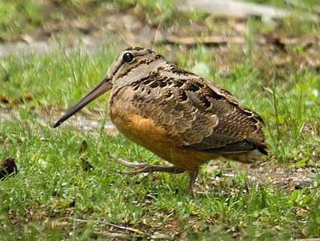
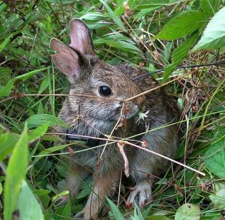
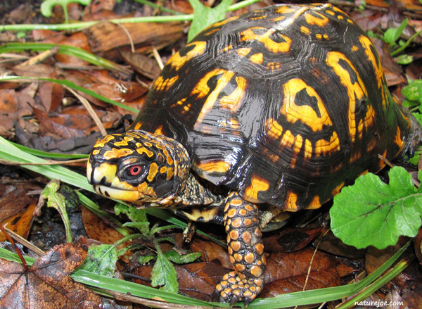
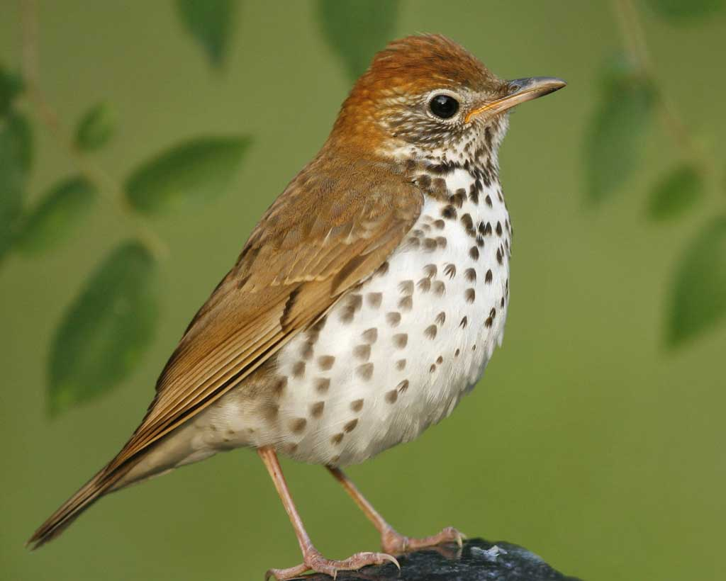
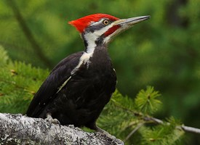
What is a “young forest”?
Notes:
When we think of forests we typically think of any place that has a lot of trees. Forest habitats can vary greatly depending on how long they have been around. Natural events such as fires and floods can reset very old “climax forests”, changing them into fields and meadows. Young forests occur about 26-50 years after a forest is reset. It is made up of dense shrubs and young trees that provide plenty of cover for smaller animals. This diagram shows the different stages of forest succession.

Slide 3
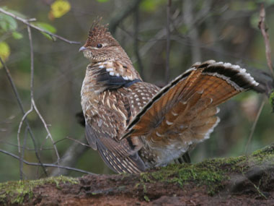
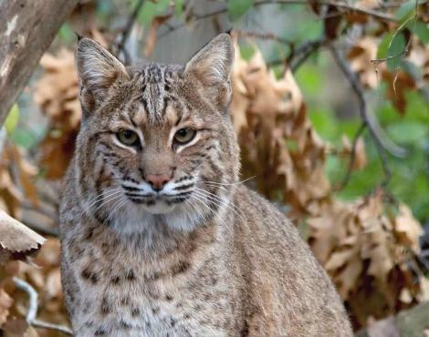

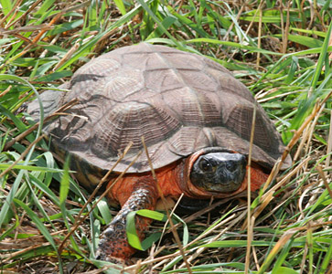
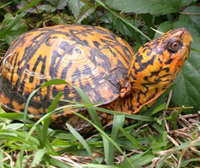
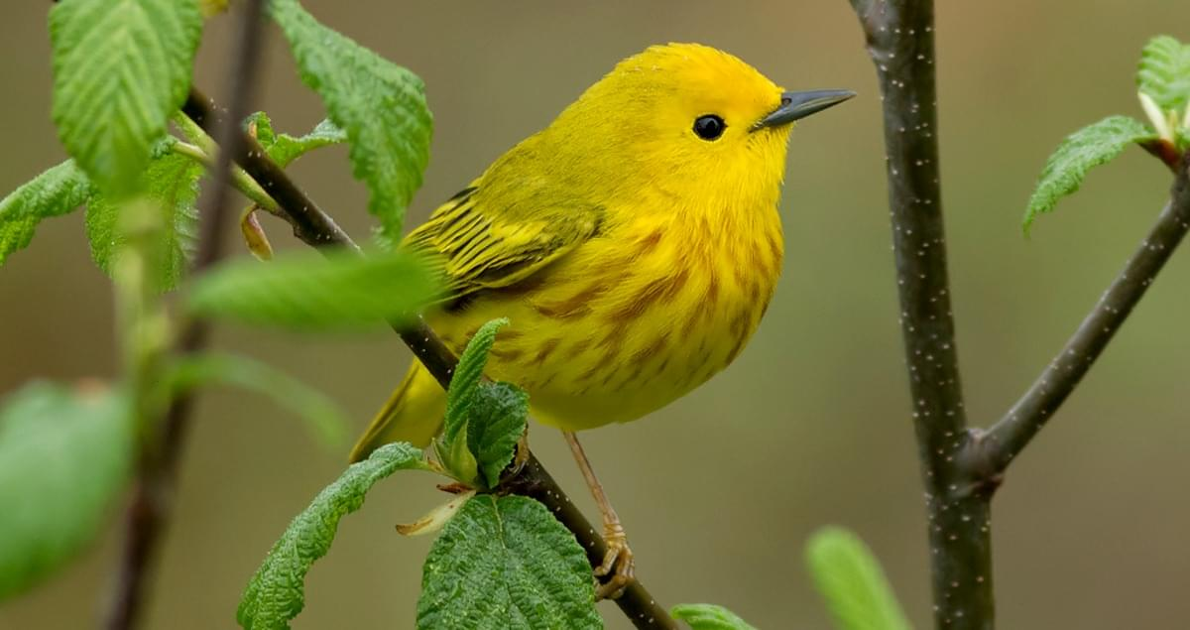
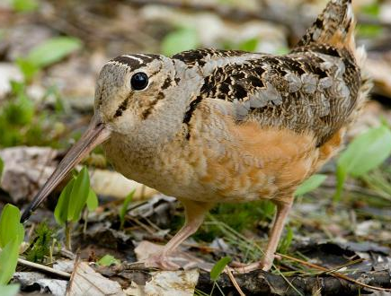
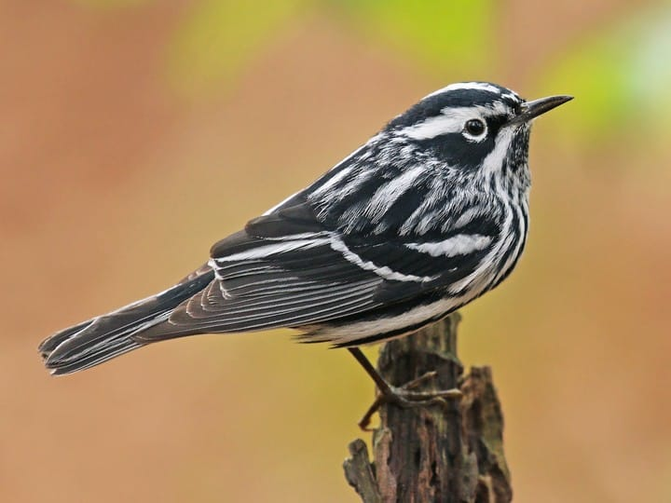
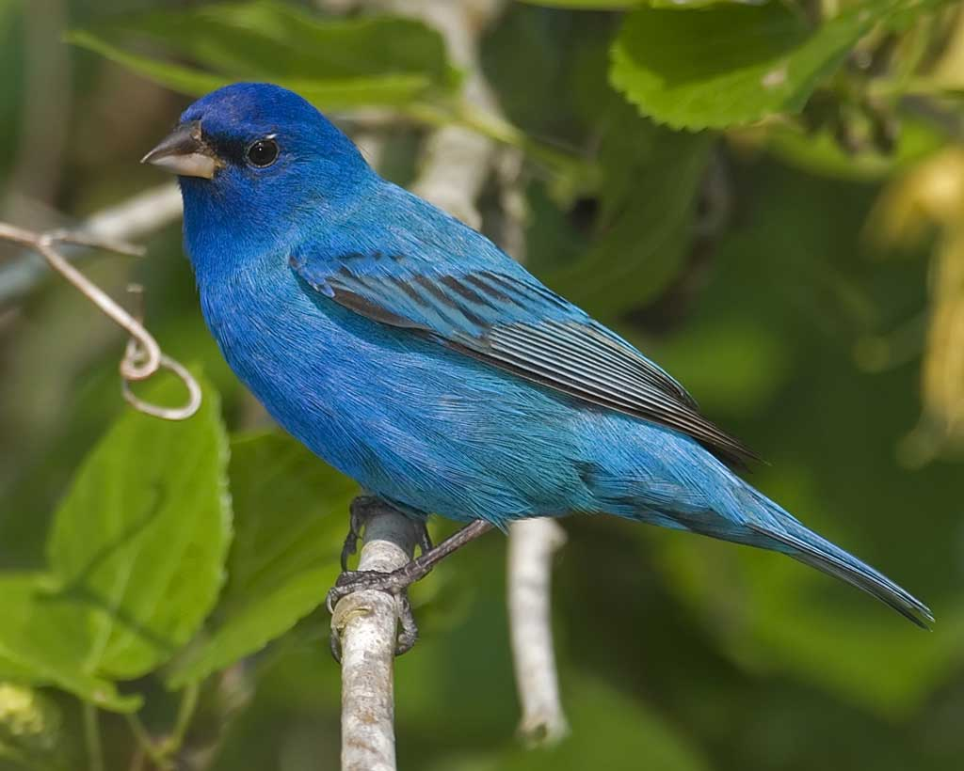
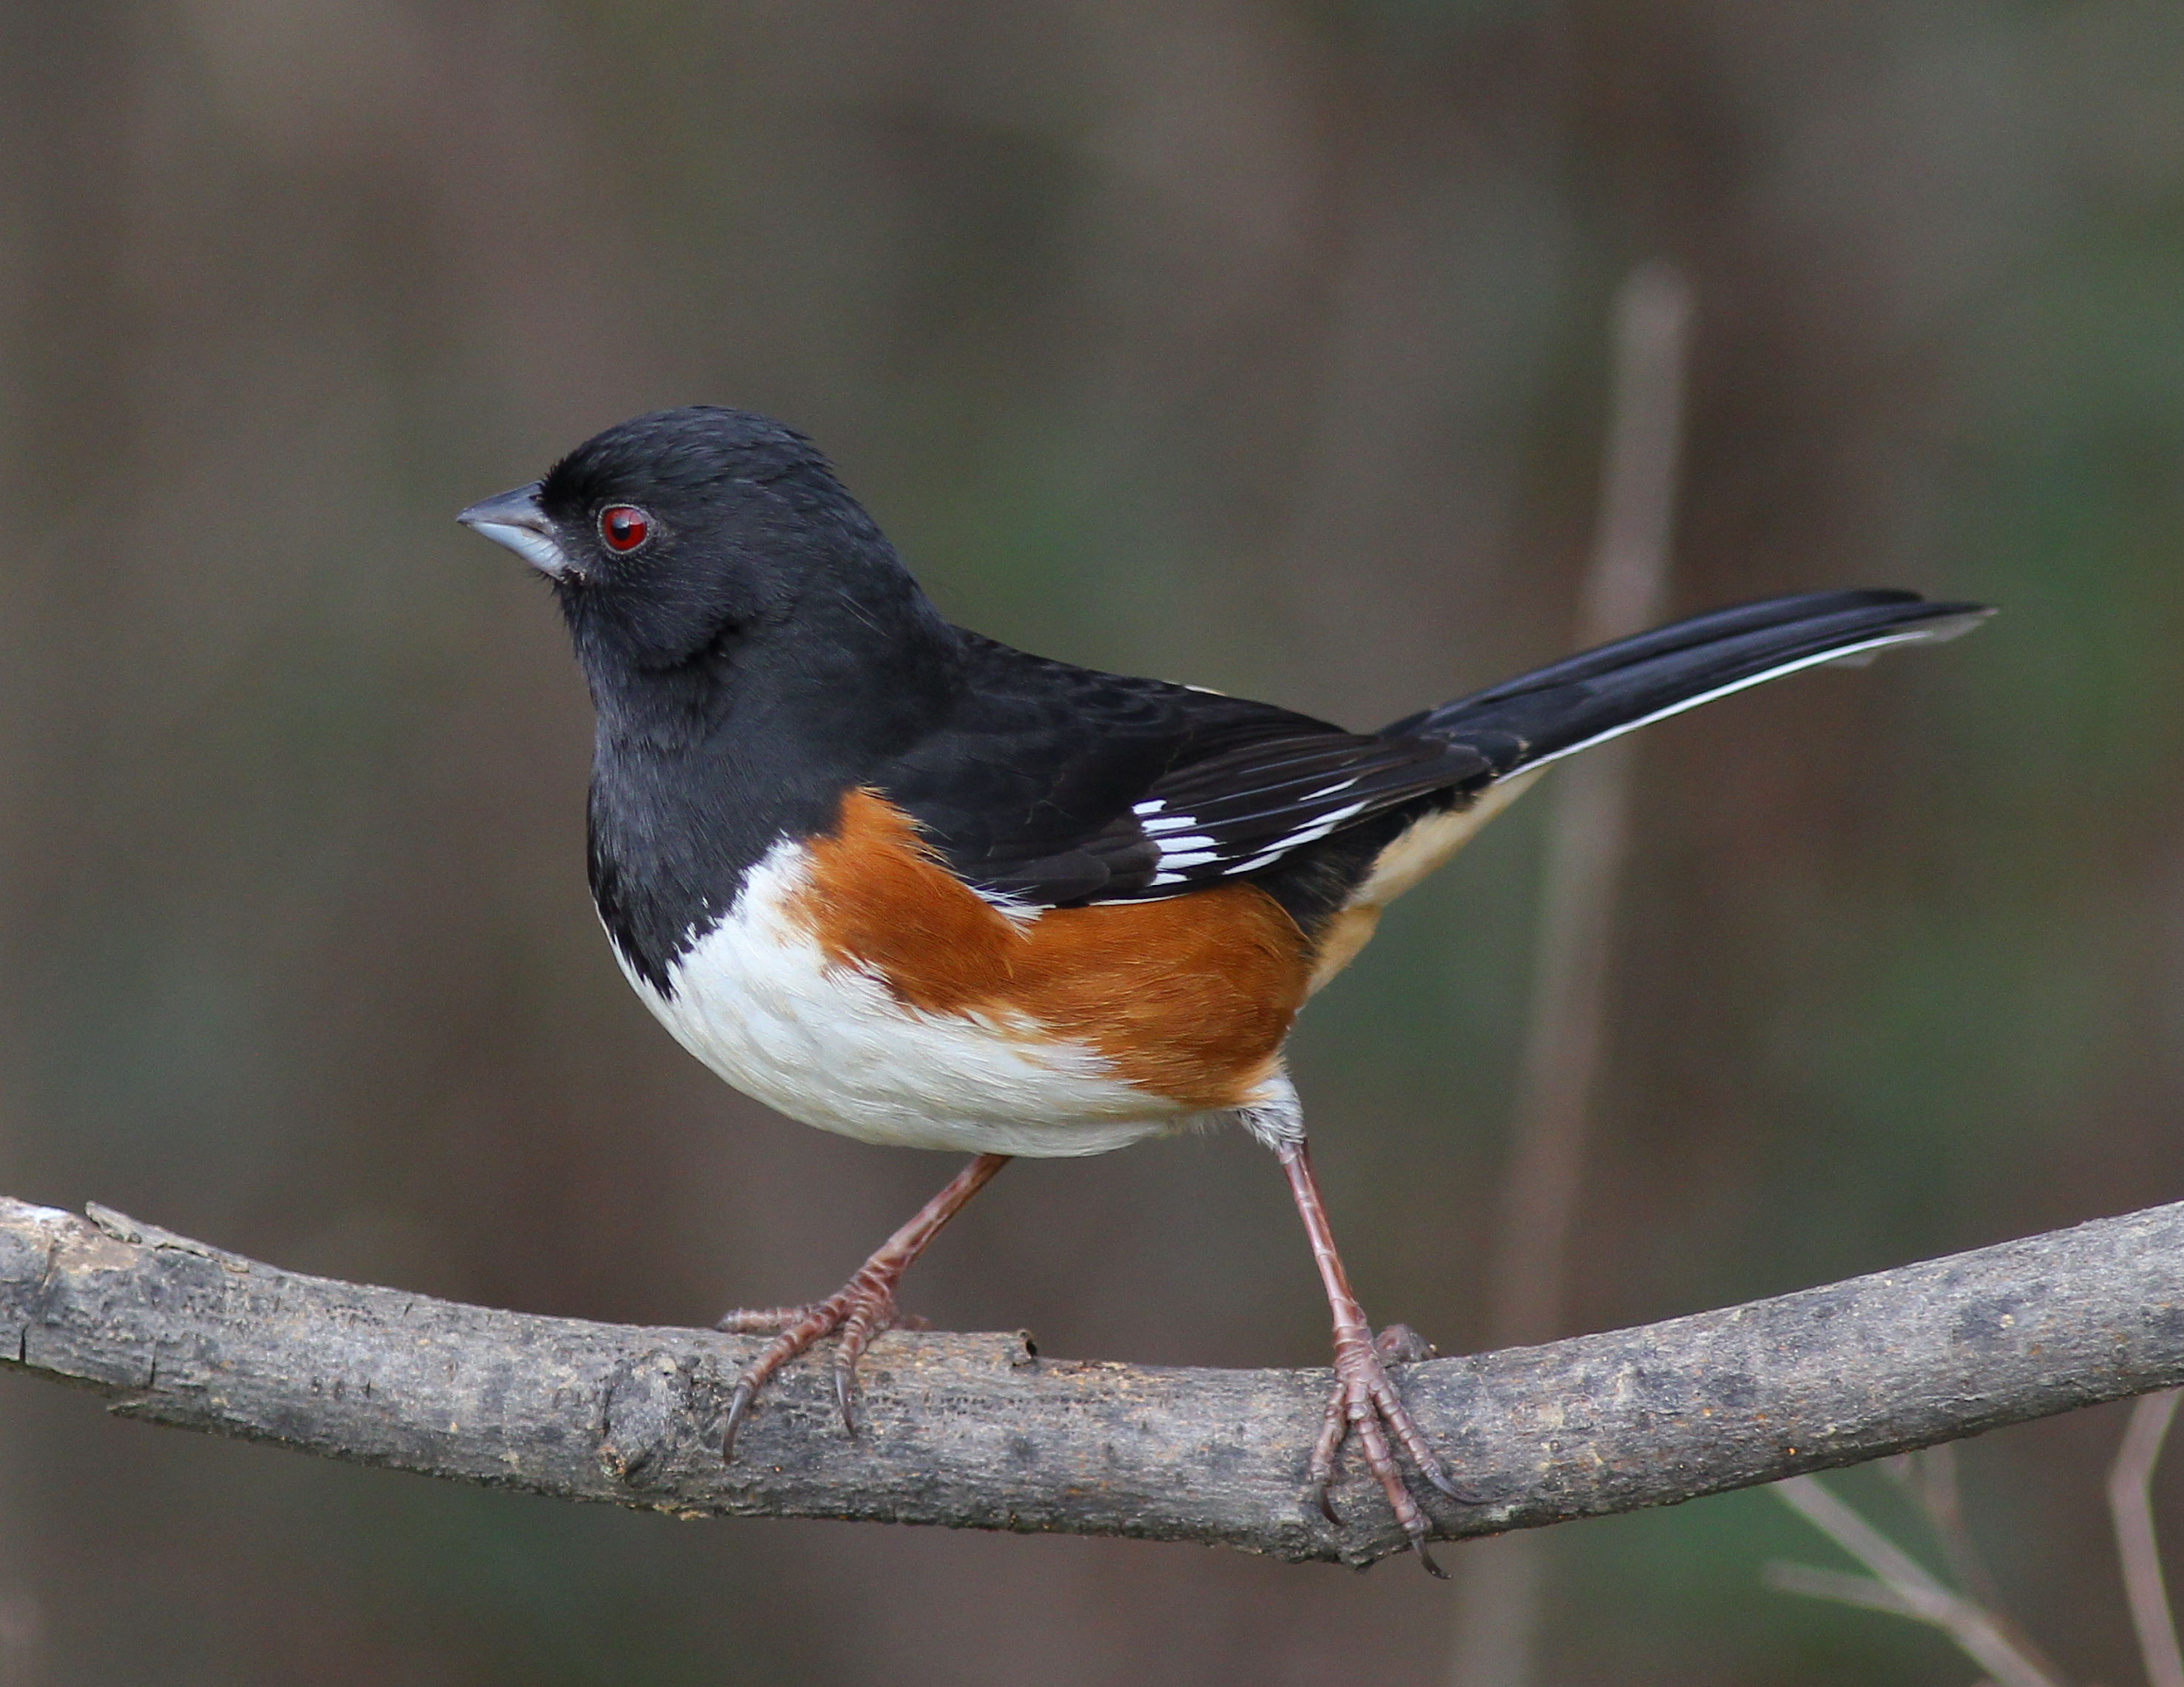
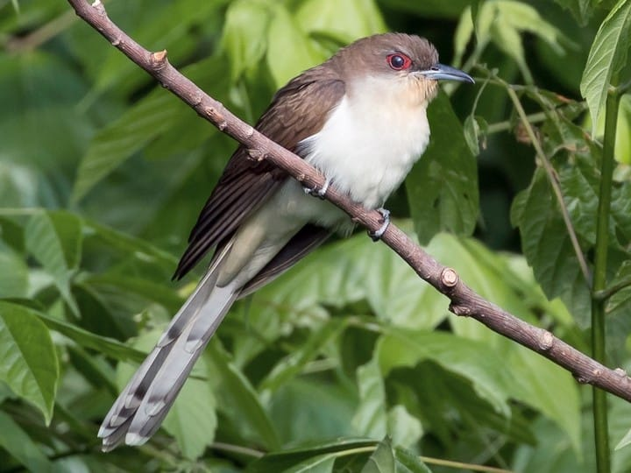
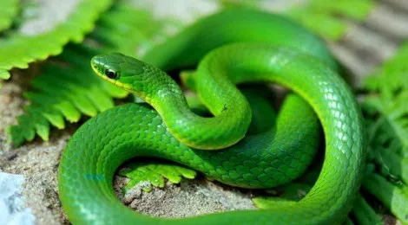
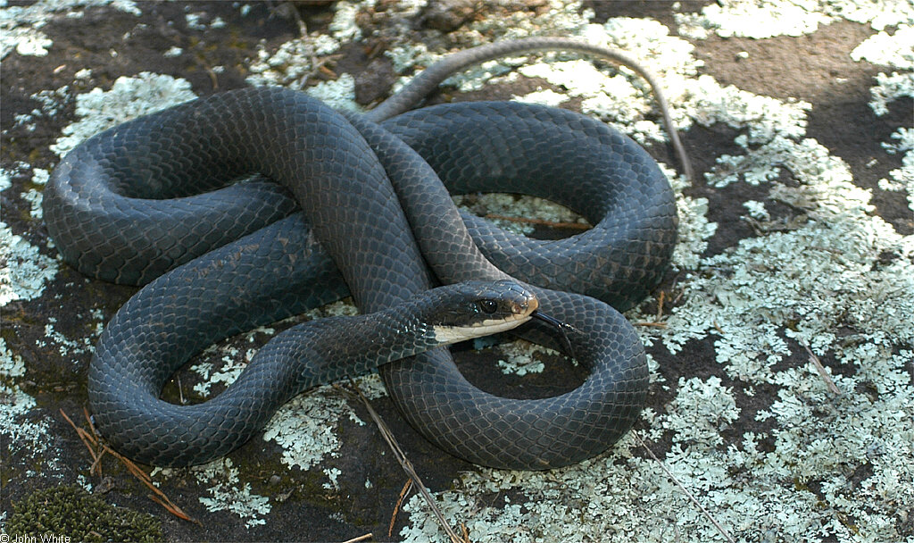
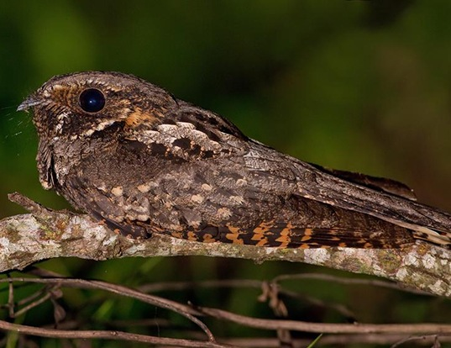
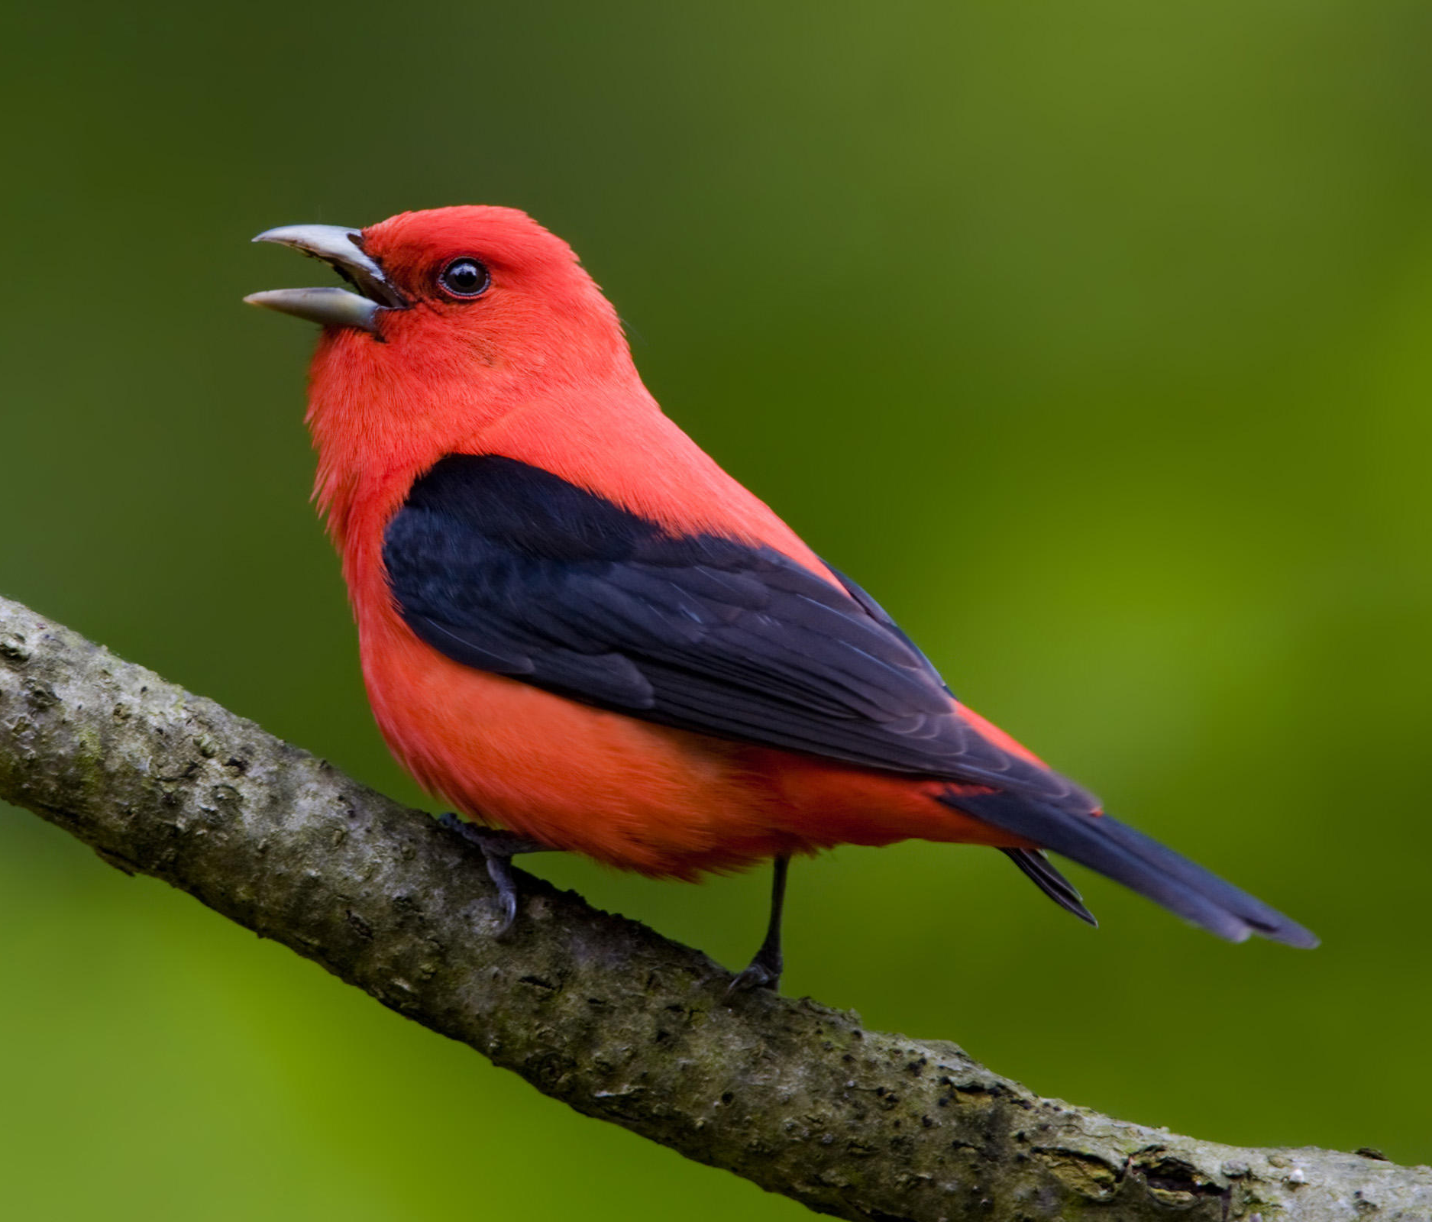
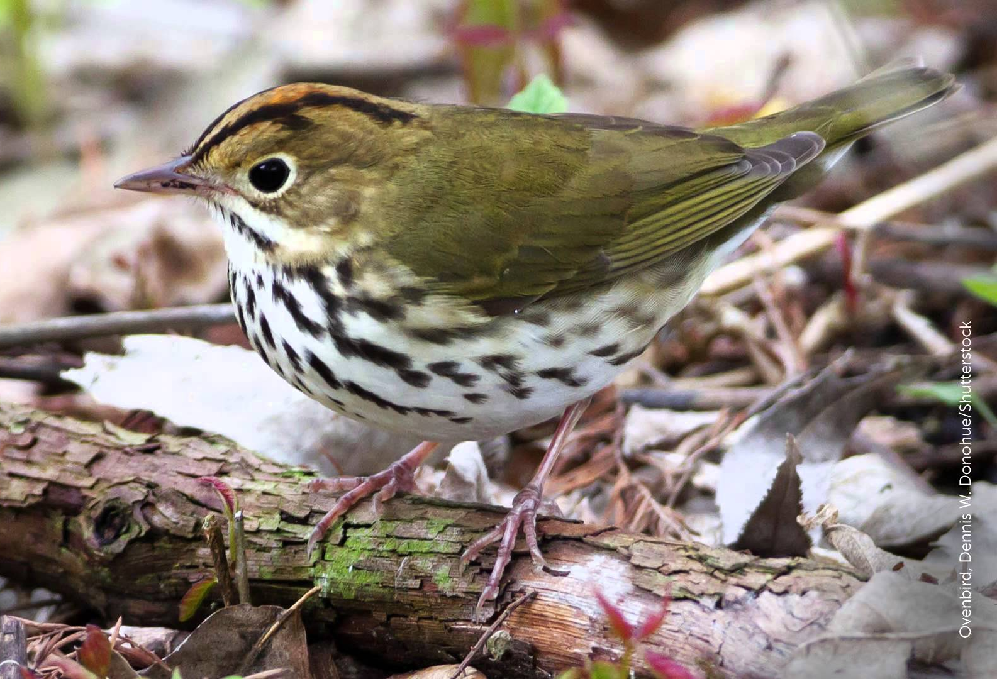
Who lives in a young forest?
Notes:
All of these animals depend on young forests to survive. Today we will discuss an important species that live in young forests in Rhode Island. The New England cottontail (circled on click)
From left to right:
Ruffed grouse, bobcat, New England cottontail, wood turtle, box turtle
Yellow warbler, American woodcock, black-and-white warbler, indigo bunting, Eastern towhee, black-billed cuckoo
Smooth green snake, black racer, whip-poor-will, scarlet tanager, ovenbird

Slide 4
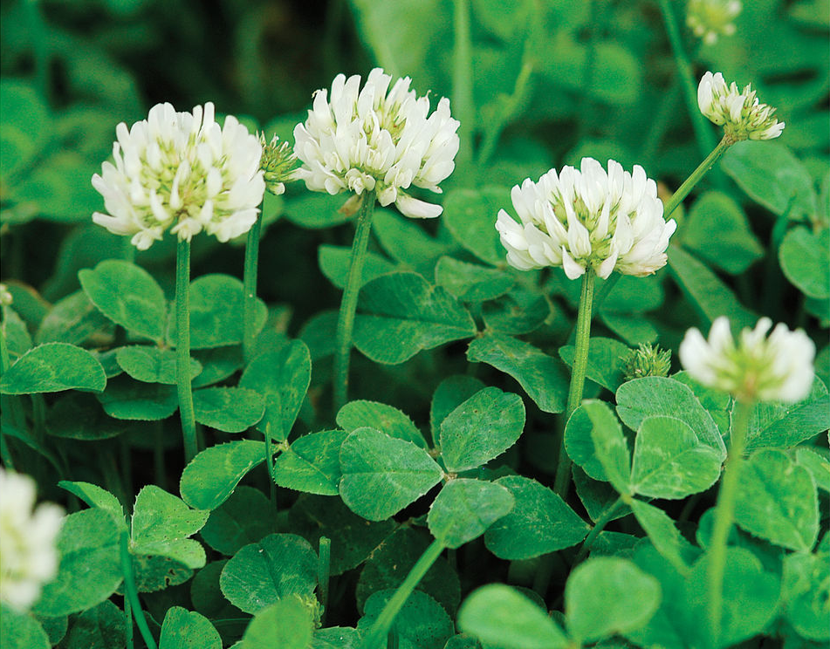
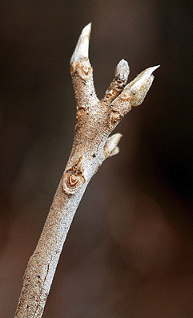
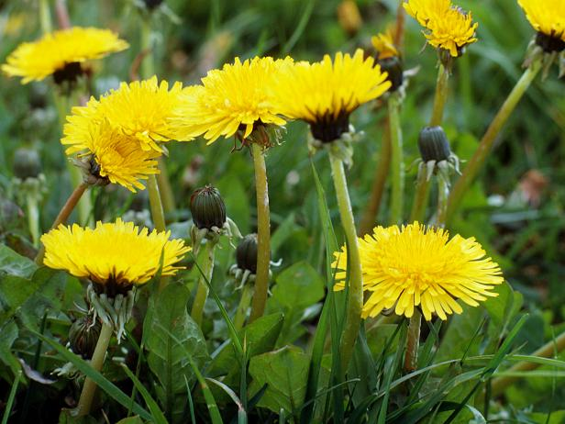
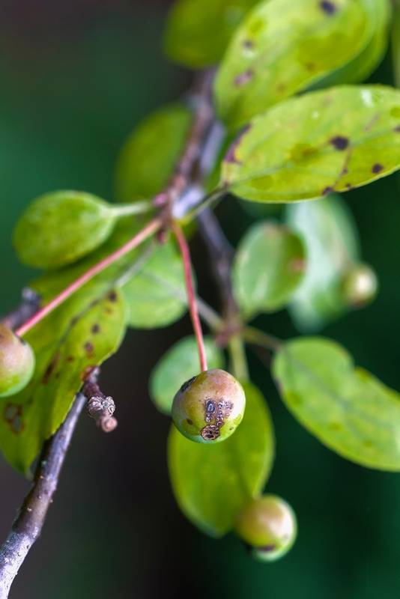

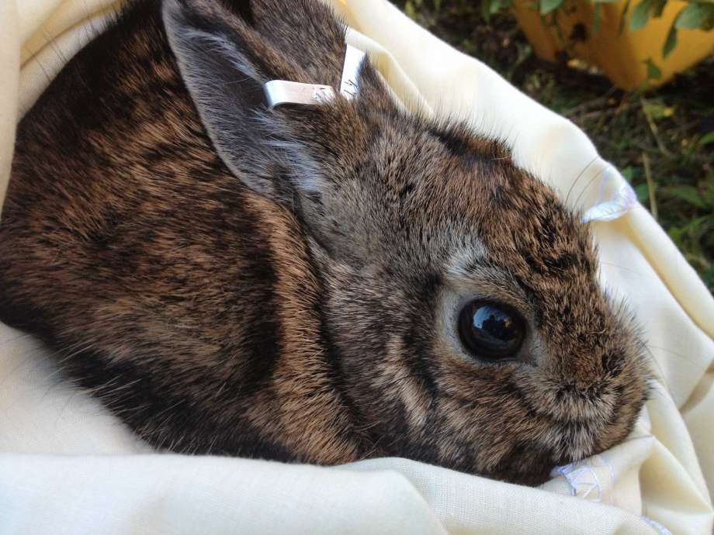
The Rabbit Life
Cottontails are herbivores!
2-3 litters per year
2-8 young per litter
Young are fully mature at 4 months
Up to 100 acre range
Notes:
Diet:
Spring & summer: grasses, clover, sprouts, dandelion
Autumn & winter: buds, stems, apple, birch

Slide 5
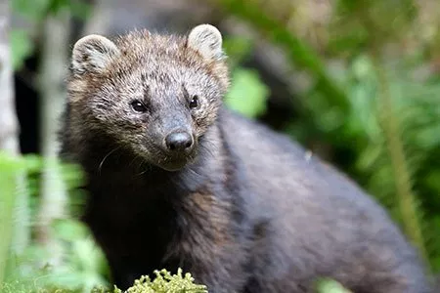
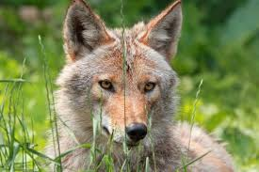
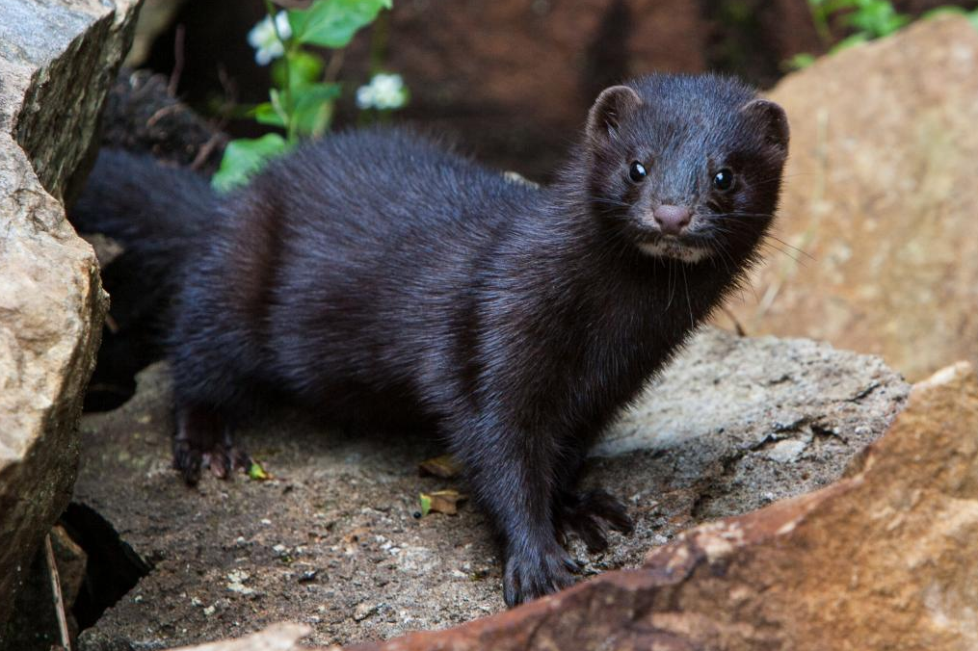
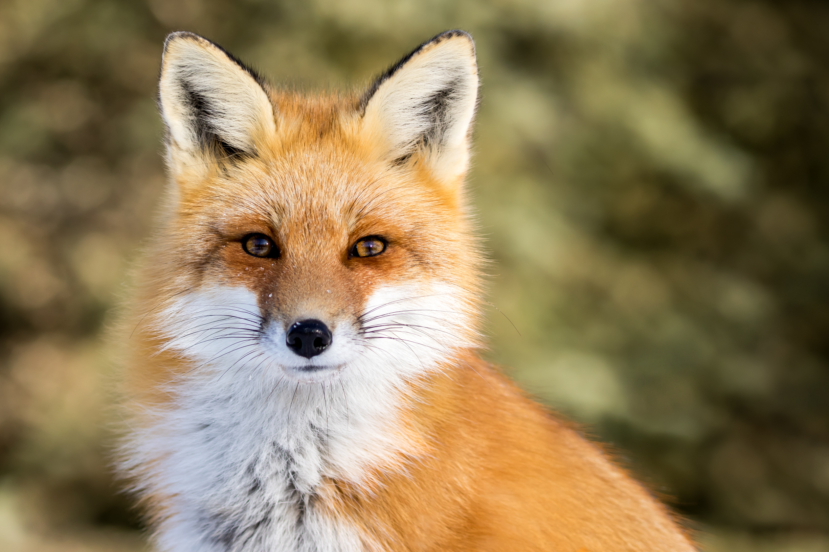
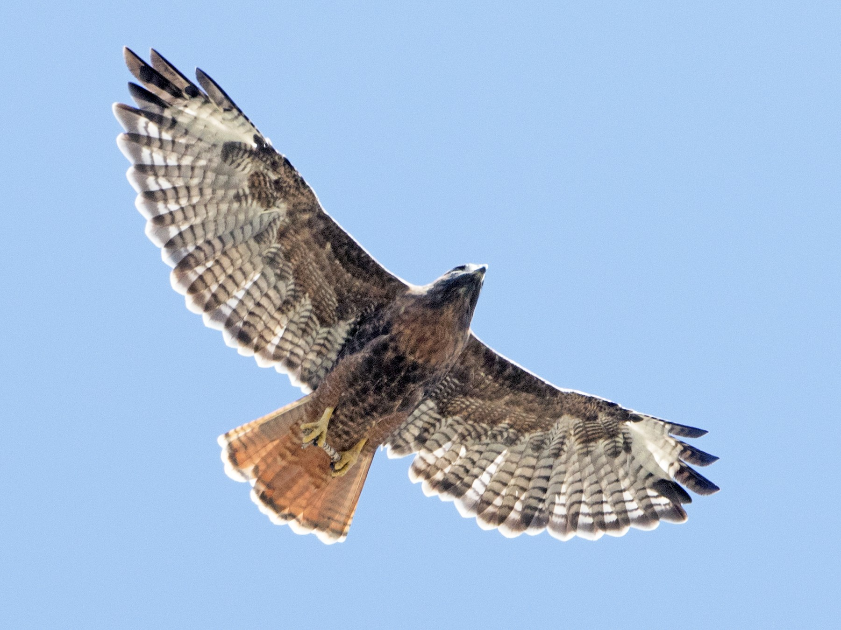
What eats a rabbit?
Notes:
Fisher, coyote, mink, fox, and raptors (birds of prey)

Slide 6
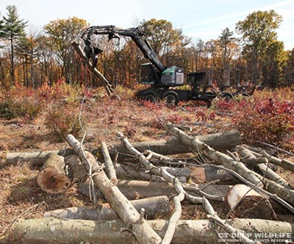
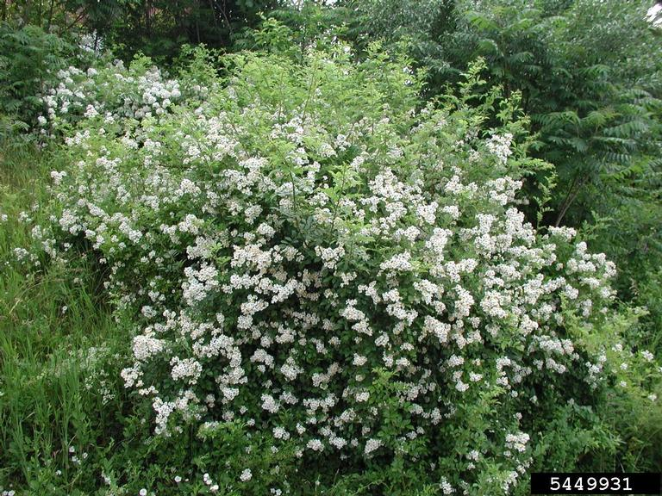
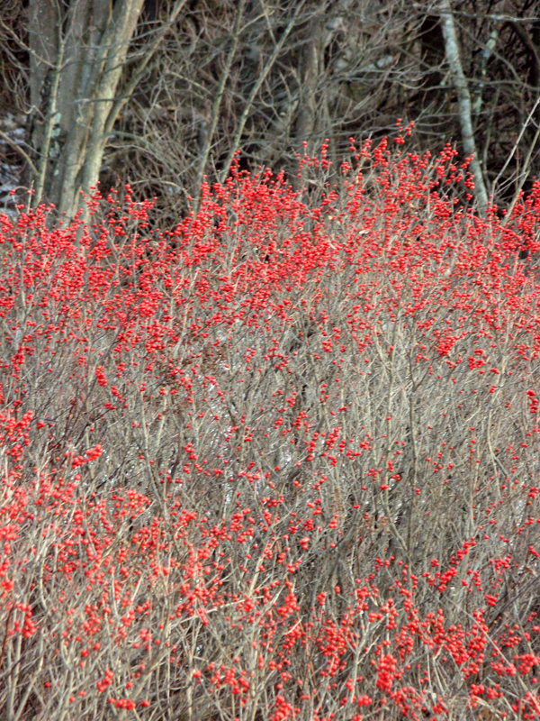
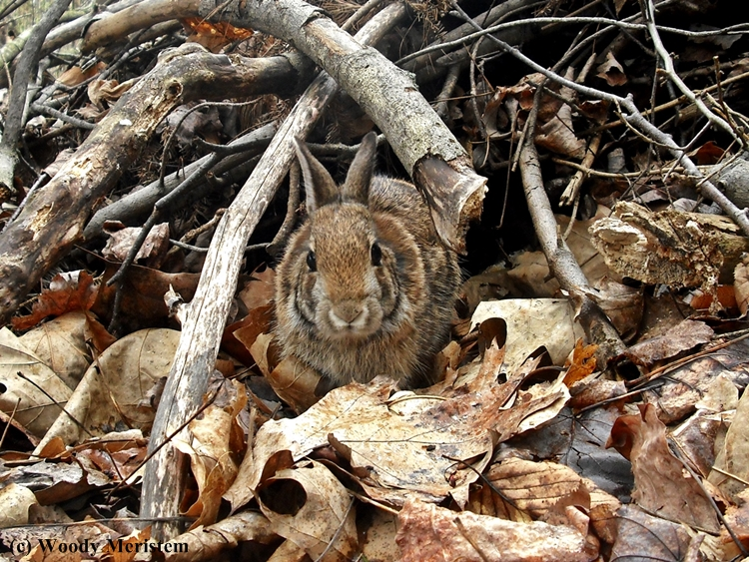
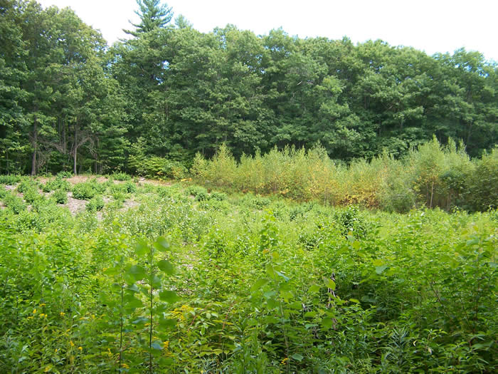
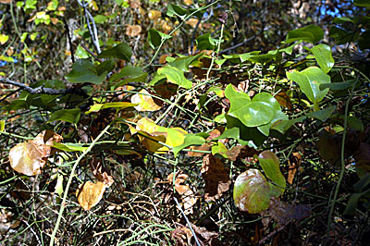
What does a young forest provide for rabbits?
Food & shelter
Brush piles
Space! Lots of habitat!
Notes:
Protection from predators, places to eat and places to rest!

Slide 7
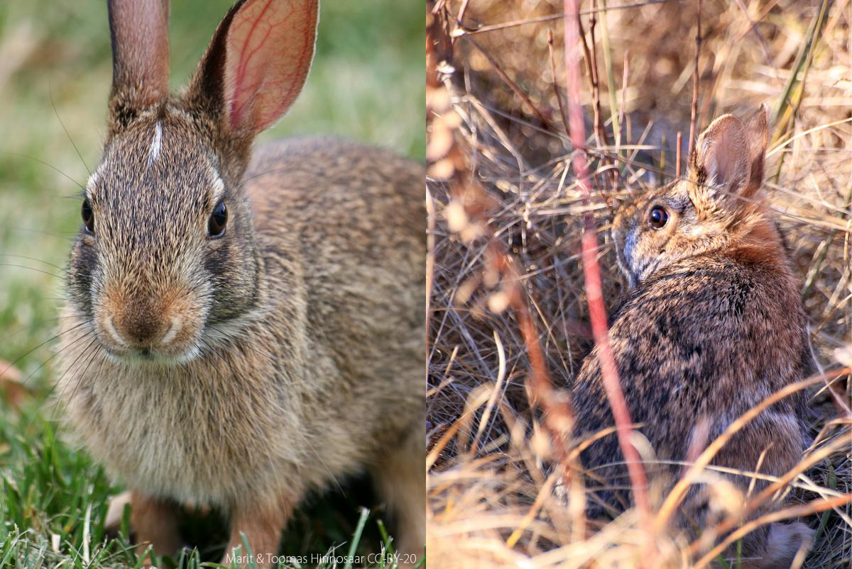
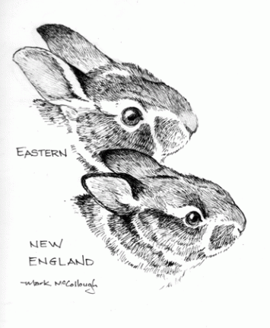
Native Invasive
New england vs. Eastern
Slightly smaller in size
Smaller ears
Small black spot on head
Slightly larger in size
Taller ears
Small white spot on head
Notes:
What’s up with New England cottontails?
New England cottontails are native species: They belong in Rhode Island and have been here forever.
Eastern cottontails were introduced for hunting stock from the southern United States; they are an invasive species: They were introduced to an area where they don’t belong
Eastern cottontails are bigger and use the food and shelter that New England cottontails need.
Play Invasive Species Game to demonstrate problems with invasive species.

Slide 8
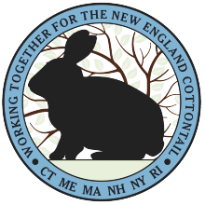
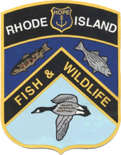
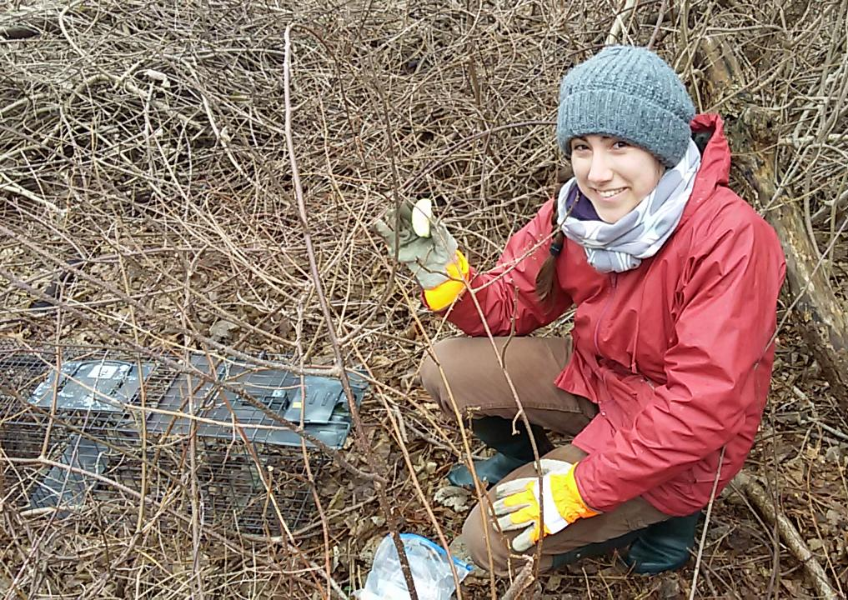
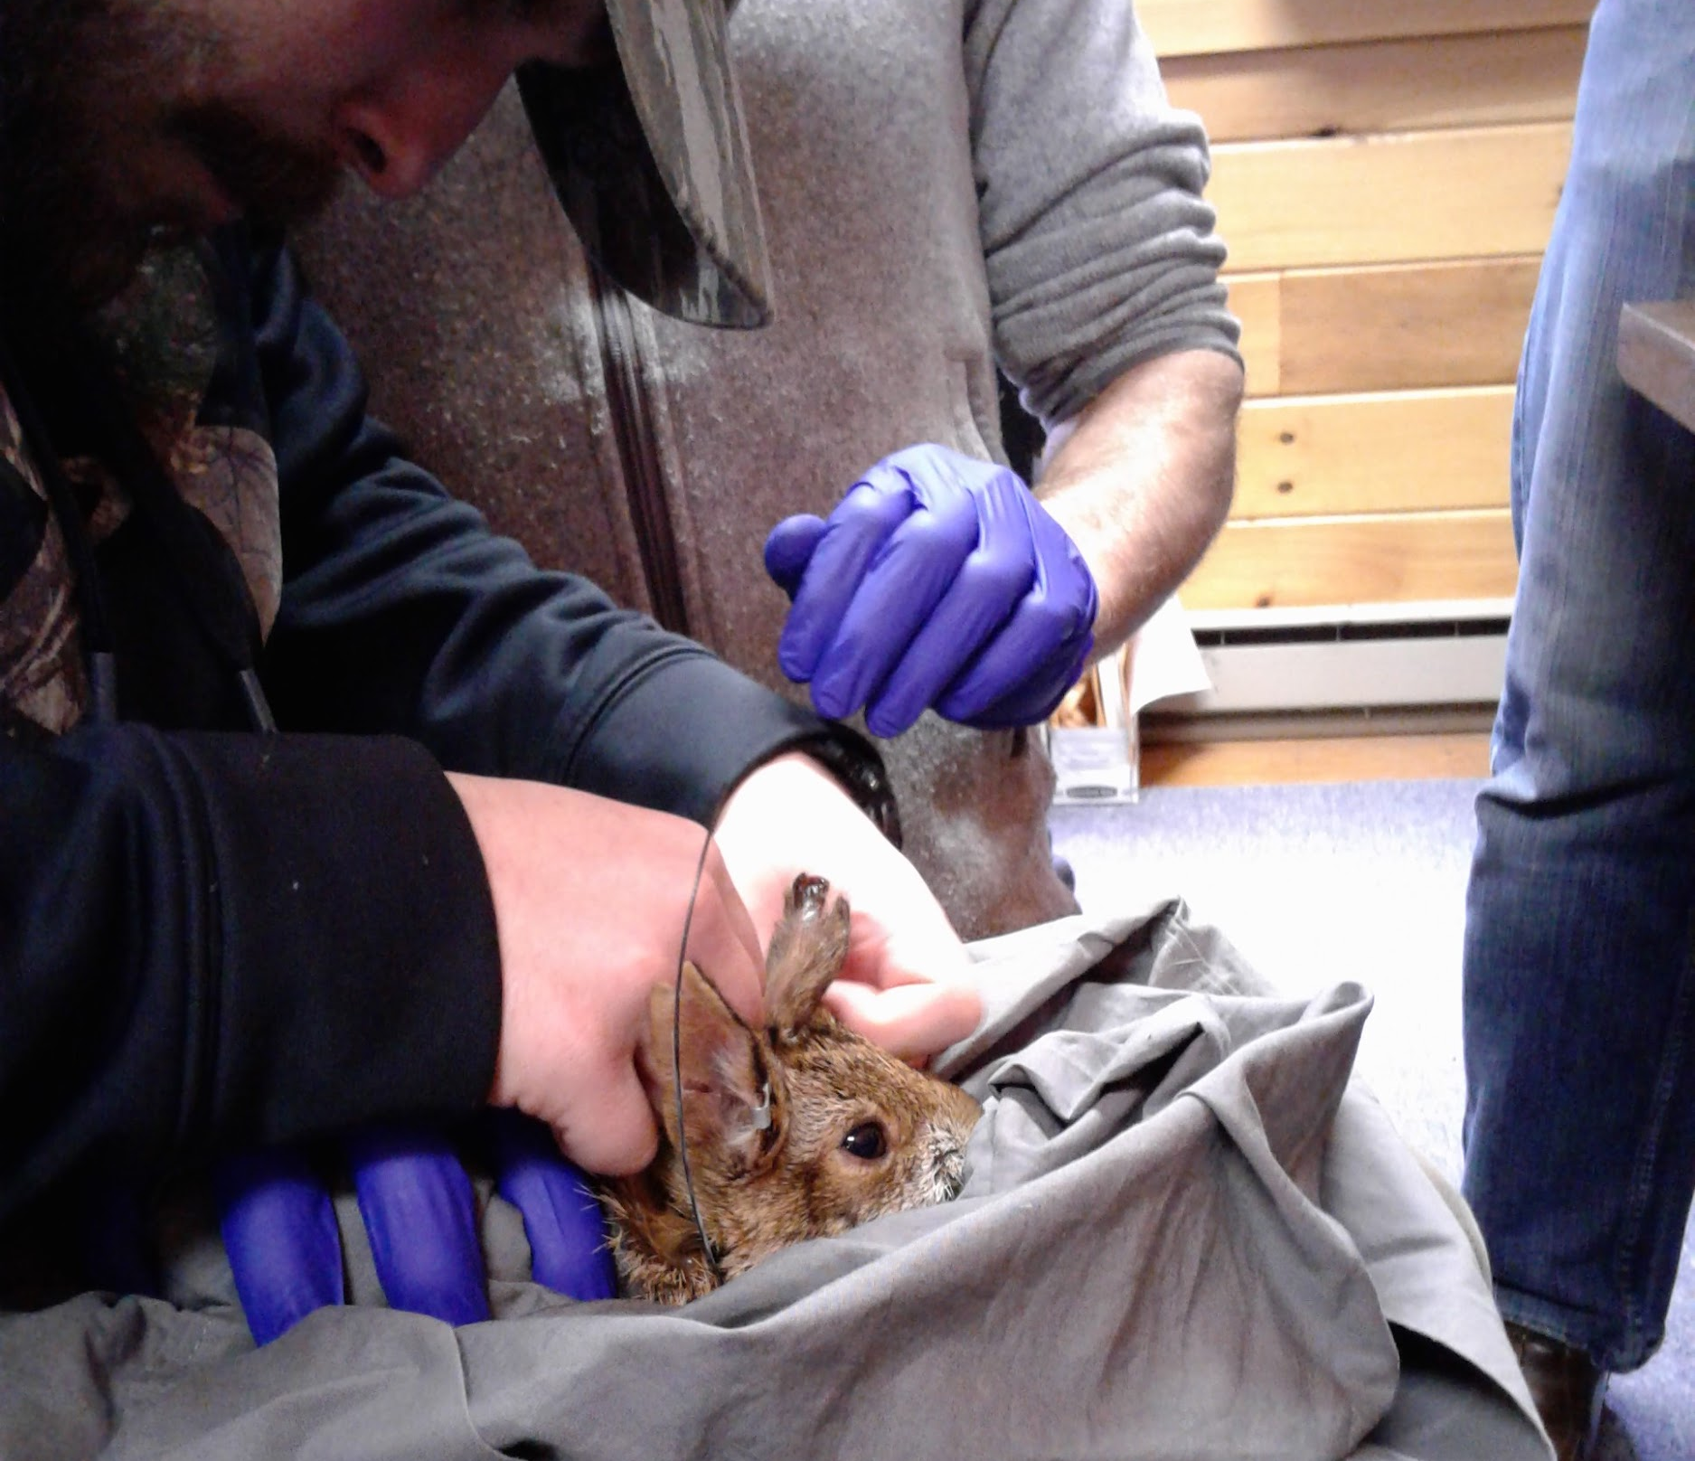
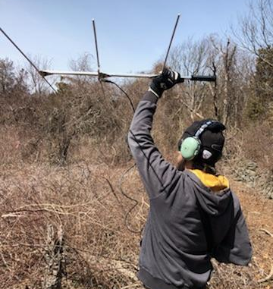



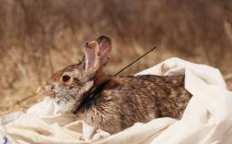
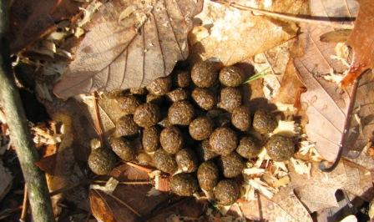
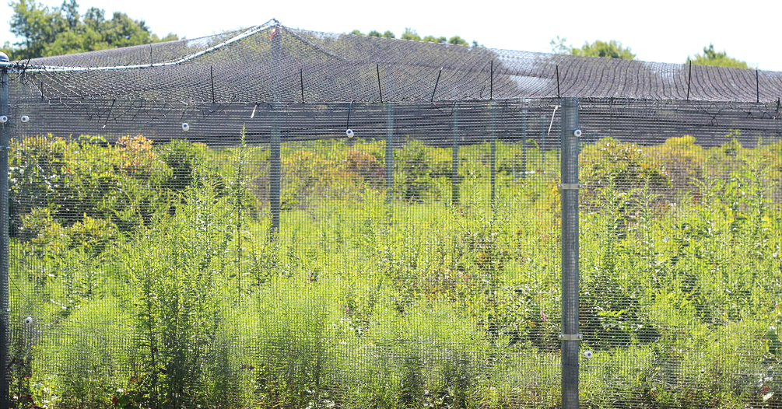





The DEM is helping!
Notes:
The DEM is working with partners to help boost and monitor NEC populations
There is a captive breeding program in which rabbits are bred in zoos then introduced to the wild, first in protected outdoor pens (bottom right) and then released to join wild populations across New England.
Some wild rabbits are trapped on Patience Island (top left) and introduced to mainland populations. These rabbits get special collars (top middle and bottom left) that allow biologists to see where they go. They use big antennae (top right) to track the collars and learn more about NEC life history.
The DEM is working with URI to see where the NEC are in Rhode Island by performing pellet surveys. This is where volunteers and biologist pick up rabbit pellets (bottom middle) and use genetic testing to see if it belongs to NEC or Eastern Cottontail rabbits.
All of these projects help us to learn more about these rabbits and what they need to survive.

